Slide 1
2020 Western PA FLL
Tournament Series and Championship
Grand Championship
Coaches Meeting
January 2021

Slide 2
Tonight’ Discussion
Welcome
Re-Cap of Season-To-Date
Details for February Championship
Q&A

Slide 3
Western PA FLL – Contacts
Gordon Walton Tournament Director gwalton@pafll.com 724.272.1747
Norm Kerman Director Emeritus normtema@msn.com
Terry Faber Head Judge / Judge Recruitment FLLJudge@moreweather.com

Slide 4
Western PA FLL Tournament Series and Championship
2020 Robotics Season
Blastoff Bonanza
Remote Event November 9th – 15th
Robot Game Only
Mid- Stage Meritocracy
Remote Event December 7th – 13th
Robot Game Only
Upper-Stage Excellence
Remote Event January 18th – 24th
Robot Game Only
Grand Championship
Championship February 15th – 21st
Robot Game and All Three Judged Categories
www.pafll.com

Slide 5
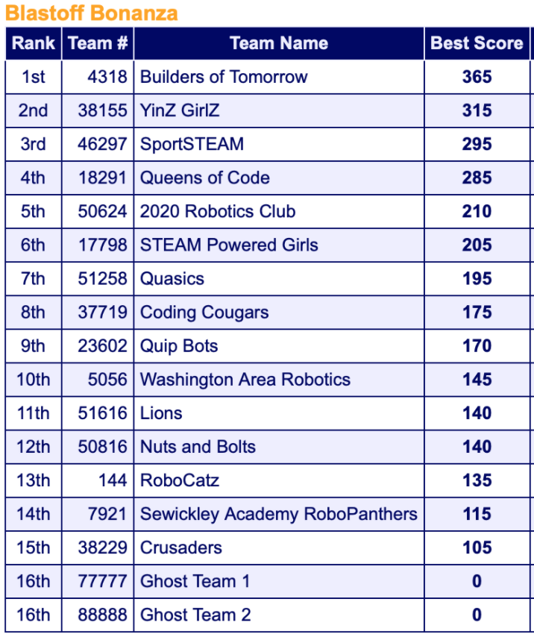
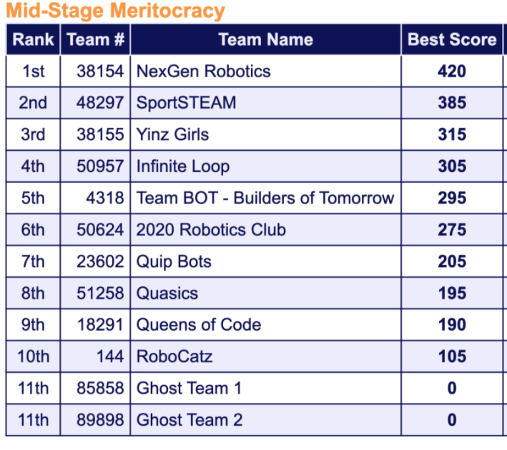
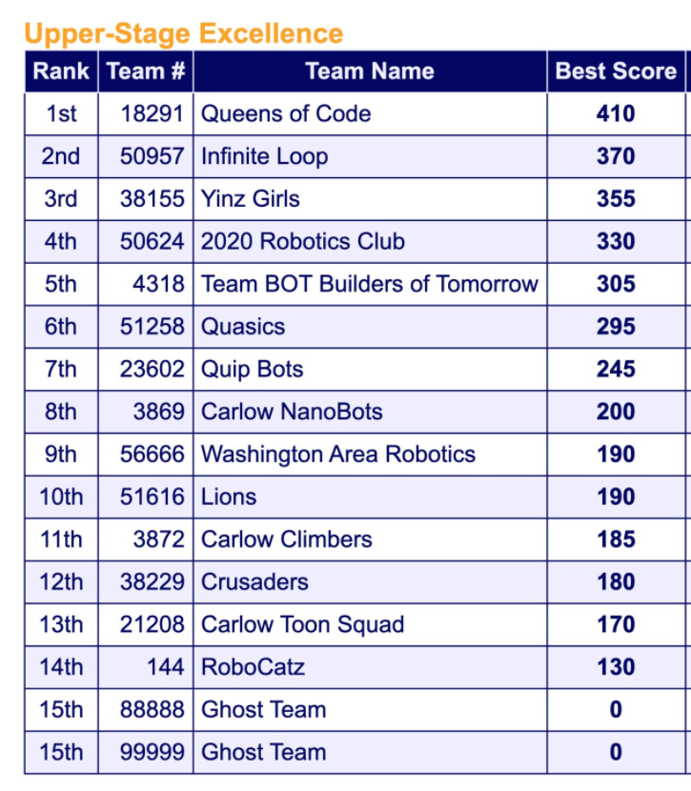
Western PA FLL Tournament Series and Championship
2020 Robotics Season - Recap
Blastoff Bonanza
Mid- Stage Meritocracy
Upper-Stage Excellence
www.pafll.com

Slide 6
Western PA FLL Grand Championship Championship Challenge Components
Judging
Robot Game
Core Values
Robot
Project

Slide 7
Western PA FLL Tournament Series and Championship
Grand Championship
Remote Championship February 15th – 21st
Robot Game
Judging
All Sessions Will Be Fully Remote
Same Format as Events To-Date
One Hour Time Slots Mon 2/15 – Sun 2/21
Up to 4 runs
Final run must start by 55 min. mark
Time-slot sign-up starts 1/26
Judging fully remote by video
Teams create a video up to 30 minutes in length
Discuss (1) Robot Design/ Programming, (2) Innovation Project and (3) Core Values (can be 1 video or 3 separate videos, but total time cannot exceed 30 minutes)
Upload as private video to YouTube and share link with gwalton@pafll.com
Share Video by 11:59 p.m. on 2/14/21
Tips:
Judging Rubrics are useful for planning
Consider visually distinguishing sections
Remember no Q&A or call backs so adjust content accordingly

Slide 8
Western PA FLL Grand Championship FLL Championship Awards
Champions Award (1st Place, 2 Runners up) Celebrating team that most embodies the FIRST LEGO League Challenge experience, by fully embracing our Core Values while achieving excellence and innovation in Robot Performance
Robot Design & Programming Award (1st, 2nd & 3rd Place) This team uses outstanding programming principles and solid engineering practices to develop a robot that is mechanically sound, durable, efficient and highly capable of performing challenge missions.
Innovation Project Award (1st, 2nd & 3rd Place) This team utilizes diverse resources for their Innovation Project to help them gain a comprehensive understanding of their problem, have a creative, well-researched solution and effectively communicate their findings to judges and the community
Core Values Award (1st, 2nd & 3rd Place) This team displays extraordinary enthusiasm and spirit, knows they can accomplish more together than they could as individual, and shows each other and other teams respect at all times
Robot Performance Award (1st – 5th Place) This award celebrates a team that scores the most points during the Robot Game. Teams compete in up to Four 2.5 minute matches and their highest score counts

Slide 9
Western PA FLL Tournament Series and Championship
Post Season Opportunities
FIRST CHAMPIONSHIP Detroit, MI August 2021
GIA – Global Innovation Award (Independent Process Over Summer)
Additional ???

Slide 10
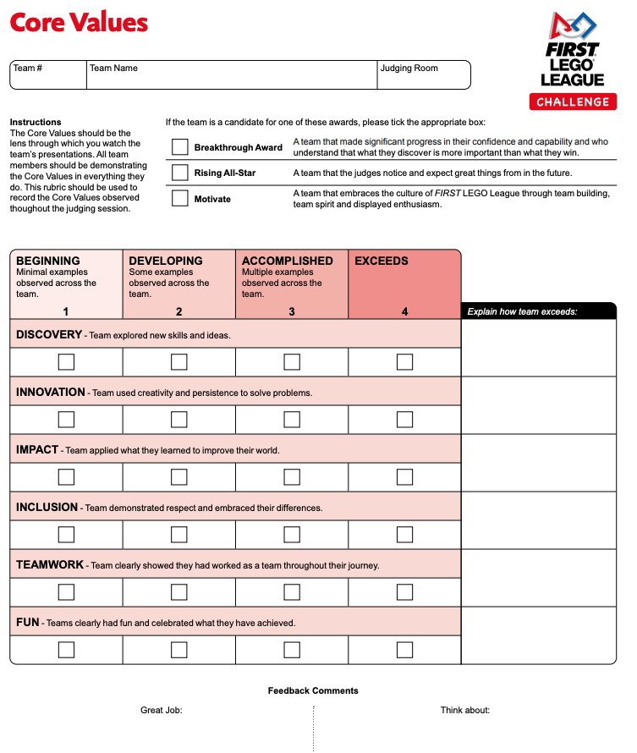
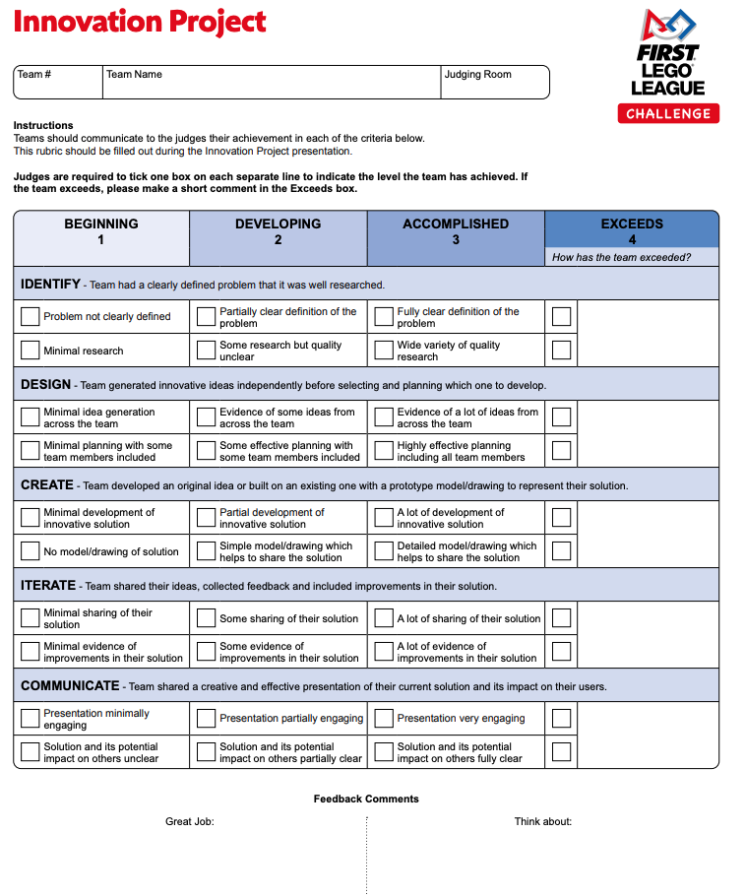
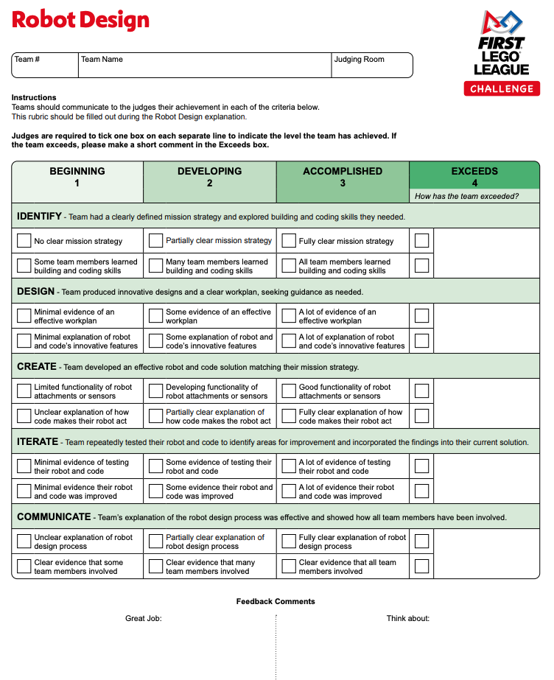
Western PA FLL Tournament Series and Championship
FLL Rubrics

Slide 11
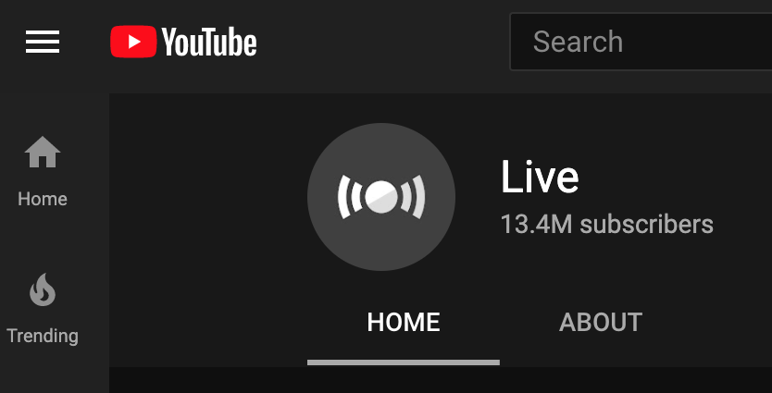
Western PA FLL Tournament Series and Championship
Championship Awards Presentation Will Be Streamed Live at 5:00 p.m. on Sunday
Link will be sent to coaches as event approaches and can be shared with team members and families
www.pafll.com

Slide 12
Good Luck!
As a final reminder...
Time-slots for Championship Game participation open for signup on 1/26
Link to Video Submission Needs to be shared with gwalton@pafll.com by 11:59 on 2/14
Gordon Walton Tournament Director gwalton@pafll.com 724.272.1747

Slide 13
Western PA FLL Tournament Series and Championship
How Will The Championship Be Conducted
Robot Game will be conducted identically to game-only events (held over 1 week with teams signing up for either remote or in person time slots)
Judging will be done fully remotely for all teams
Teams will submit one video on or before 2/14/2021
Should cover all three areas (Robot, Project and Core Values)
Video can be up to 30 minutes in Length
No additional interviews, so include whatever you think is important
Awards Ceremony will be held live Sunday Afternoon
www.pafll.com

